Slide 1





Slide 2
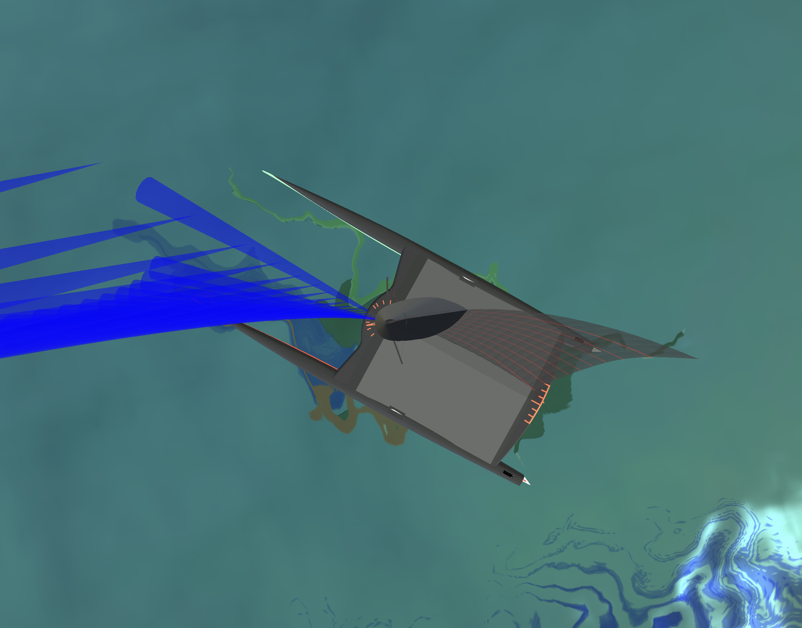

Slide 3
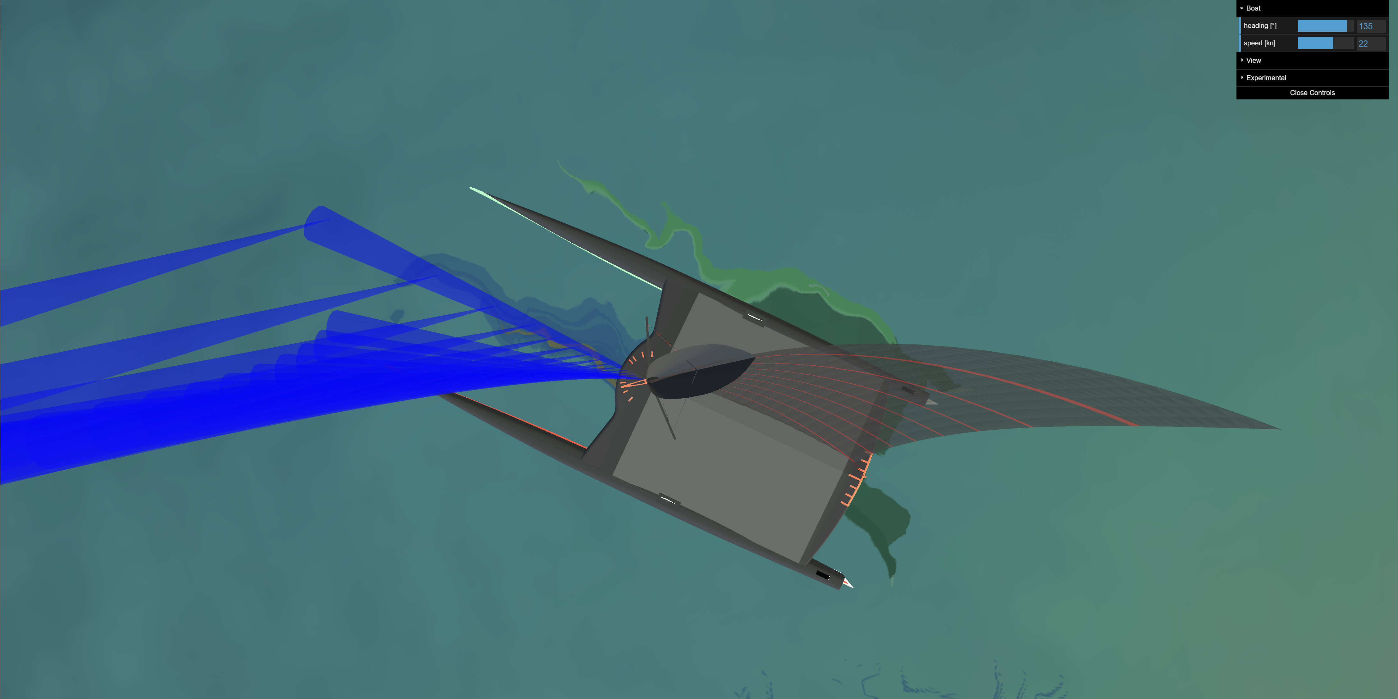
20°
chord angle
of attack
camber
10%
apparent wind
45%
chord
camber position
-5° mast angle
of attack

